Slide 1
ListReader: Inducing Wrappers for OCRed Lists to Efficiently Populate Ontologies
Thomas L. Packer
October 6, 2014

Slide 2
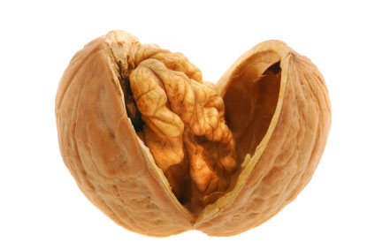
Dissertation in a Nutshell
Challenge: Low-cost ontology population
Focus: Data in lists of OCRed documents
Thesis: Wrapper induction is effective

Slide 3
Outline
Motivation & Challenges
Solutions
Data Mapping
Local Wrapper Induction
Global Wrapper Induction
Conclusions

Slide 4
Motivations & Challenges

Slide 5
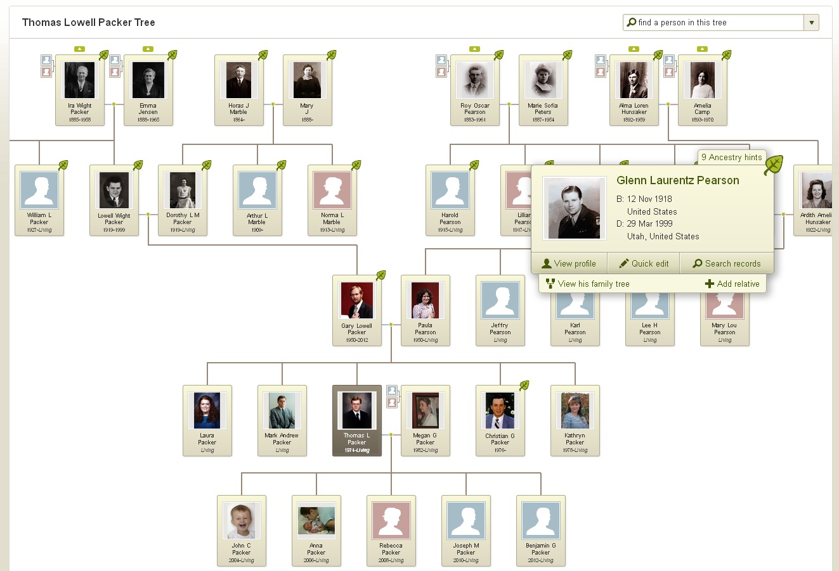
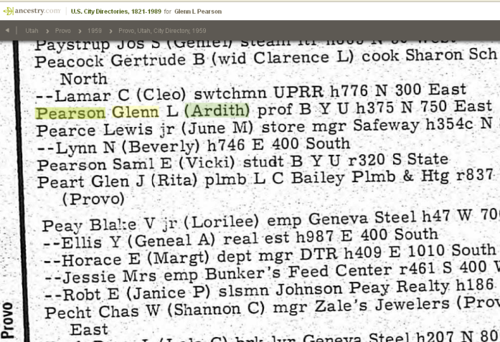
Motivation

Slide 6
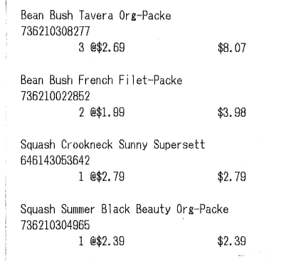
Other Domains and Applications
Printed receipts
Marketing app. (Itemize.com)
Personal finance app. (Itemize.com)
Travel reimbursement app.
Nutrition app. (Noshly.com)
Digitize library catalog
Citation metrics
Museum Specimen Labels

Slide 7
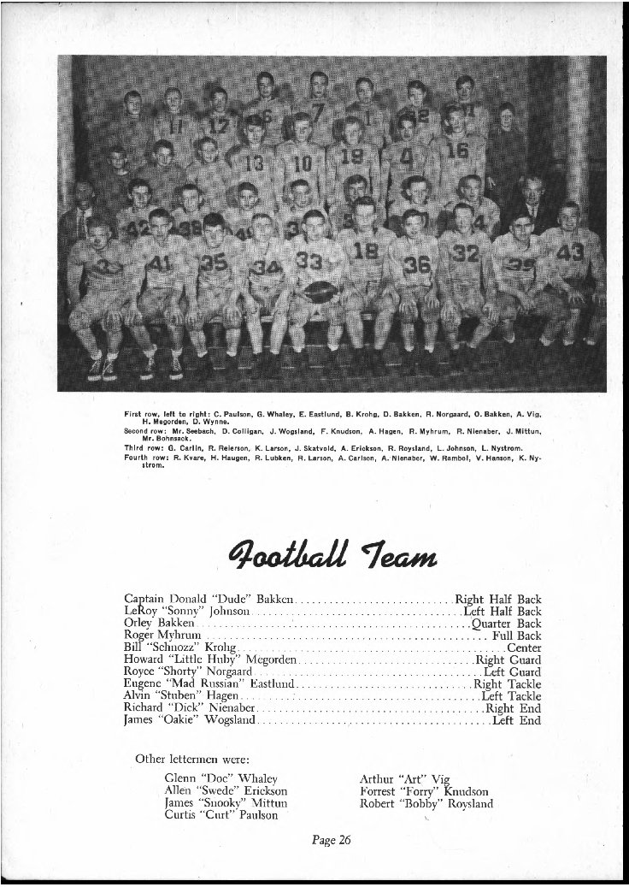
OCR Text Challenges
…
Captain Donald "Dude" Bakken ............... Right Half Back\nLeRov "Sonny' Johnson ........ ..........,.... Lcft Half Back\nOrley Bakken ...........,........ ... ,.......... Quarter Back\nRoger Myhrum .............. ..................... Full Back\nBill "Schnozz" Krohg .............. ................ Center\nHoward "Little Huby" Megorden ................ Right Guard\nRoyce "Shorty" Norgaard ....................... Left Guard\nEugene "Mad Russian" Easthind ............... Right Tackle\n
…
OCR
vs. a Web Page
<HTML>
…
<OL>
<LI>Captain Donald "Dude" Bakken ............... Right Half Back</LI>
<LI>LeRoy "Sonny” Johnson ....................... Left Half Back</LI>
<LI>Orley Bakken .................................. Quarter Back</LI>
<LI>Roger Myhrum ................................... Full Back</LI>
<LI>Bill "Schnozz" Krohg .............................. Center</LI>
<LI>Howard "Little Huby" Megorden ................ Right Guard</LI>
<LI>Royce "Shorty" Norgaard ....................... Left Guard</LI>
<LI>Eugene "Mad Russian" Eastlind ............... Right Tackle</LI>
…

Slide 8
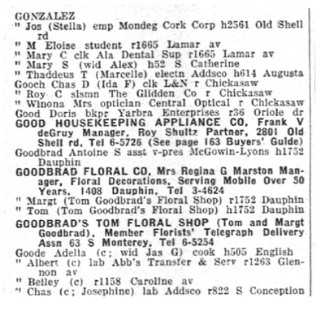
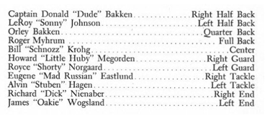
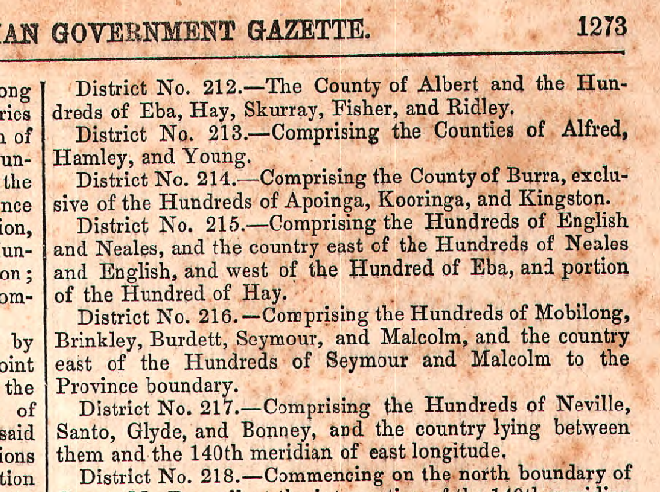
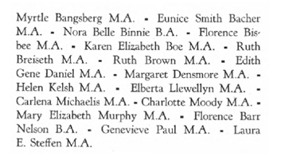
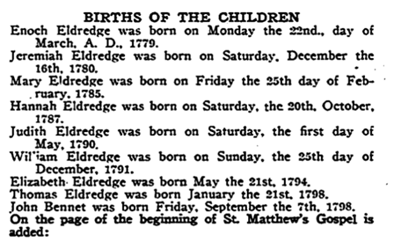
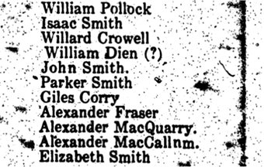
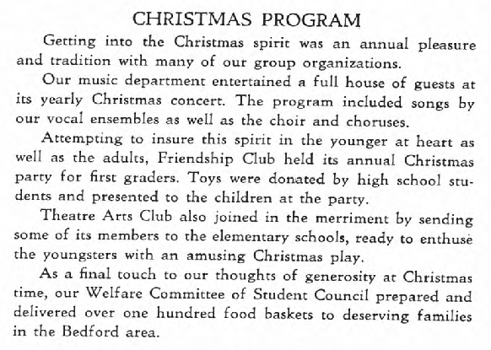
“Big Data” Challenges

Slide 9
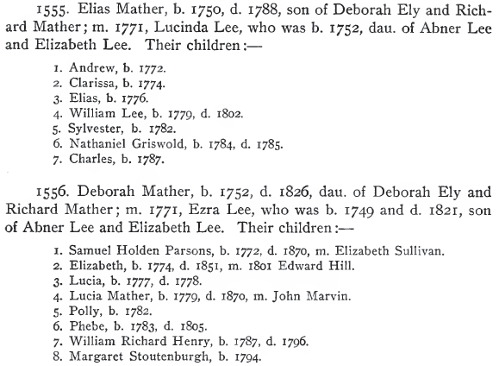
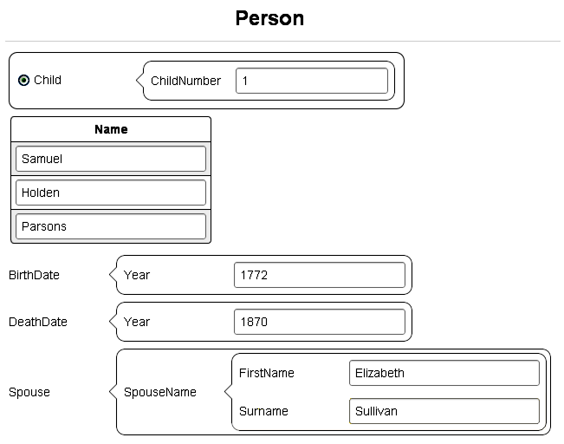
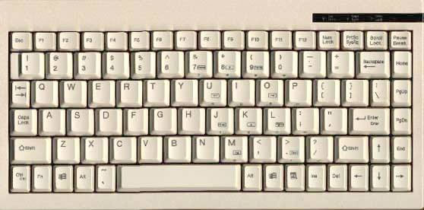
Human Effort Challenges
Regular Expressions for Dates
^(0[1-9]|1[012])[- /.](0[1-9]|[12][0-9]|3[01])[- /.](19|20)\d\d$.
^(0[1-9]|[12][0-9]|3[01])[- /.](0[1-9]|1[012])[- /.](19|20)\d\d$ …
Regular Expression for Records
(([\n])([\d]{1})(\.[ \n])(([A-Z]+[a-z]+|[A-Z]+[a-z]+[A-Z]+[a-z]+)|([A-Z]+[a-z]+|[A-Z]+[a-z]+[A-Z]+[a-z]+)([ \n])([A-Z]+[a-z]+|[A-Z]+[a-z]+[A-Z]+[a-z]+)|([A-Z]+[a-z]+|[A-Z]+[a-z]+[A-Z]+[a-z]+)([ \n])([A-Z]+[a-z]+|[A-Z]+[a-z]+[A-Z]+[a-z]+)([ \n])([A-Z]+[a-z]+|[A-Z]+[a-z]+[A-Z]+[a-z]+)|([A-Z]+[a-z]+|[A-Z]+[a-z]+[A-Z]+[a-z]+)([ \n])([A-Z]+[a-z]+|[A-Z]+[a-z]+[A-Z]+[a-z]+)([ \n])([A-Z]+[a-z]+|[A-Z]+[a-z]+[A-Z]+[a-z]+)([ \n])([A-Z]+[a-z]+|[A-Z]+[a-z]+[A-Z]+[a-z]+)|([A-Z]+[a-z]+|[A-Z]+[a-z]+[A-Z]+[a-z …
Given Names
Ali
Alison
Alex
Andie
Andy
Ariel
Caroline
Chris
Cindy
Claire
Corey
Daisy
Diane
…
Surnames
Adams
Allen
Anderson
Baker
Brown
Campbell
Clark
Davis
García
González
Green
Hall
Harris
…
Months
Jan.
January
Feb.
February
Mar.
March
Apr.
April
May
Jun.
June
Jul.
July
…
Predicates
b.
born
born on
baptized
was baptized
was baptized on
was baptized in
d.
died
died on
m.
married
was married to
…

Slide 10
Solutions

Slide 11
Summary of Related Work and Present Contributions
 | Input Handling and Project Scope |  |  | Process Scalability |  |  | IE Output
 | 1. OCR / Noise Tolerant | 2. General Text List Detection | 3. General Text List Info. Extr. | 4. Alg. Time & Space Complexity | 5. Human Cost Engineering Knowledge | 6. Human Cost Annotating Examples | 7. Rich Ontology Population | 8. Precision | 9. Recall
Related Work
Grammar Induction | NR | NR | NR | Bad | Very Good | Very Good | NR | NR | NR
Traditional IE * | Good | OK | OK | OK | Bad | OK | OK | Good | Good
Web Wrapper Induction | NR | NR | OK | Good | OK | Good | OK | Good | Good
Specialized DAR Systems | Good | OK | OK | NR | Bad | Bad | OK | Good | Good
Dissertation Work
List Detection | OK | Good | NR | Very Good | OK | Very Good | NR | NR | NR
Local Regex | Good | OK | Good | Bad | Good | OK | Good | Very Good | OK
Local HMM | Good | OK | Good | OK | Good | OK | Good | Good | Good
Global Regex | OK | Good | Good | Very Good | Good | Good | Good | Very Good | OK
Global HMM | Good | Good | Good | Good | Good | Good | Good | Good | Good
* Our baseline comparison system is a Conditional Random Field (CRF)

Slide 12
Data Mapping (Packer and Embley, 2014b, 2014a, 2013)

Slide 13
Typical Data Extraction
Object-Set Labels
Named Entity Recognition
(Categorizing)
Flat Attribute Extraction
(Grouping and Categorizing)
Relation Extraction
(Grouping and Categorizing)

Slide 14
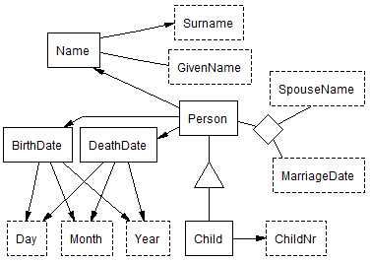
ListReader Data Extraction
Ontology-Path Labels
Person.(MarriageDate)SpouseName[1]
Edward Hill
Person.(SpouseName)MarriageDate[1]
1801
Person-SpouseName-MarriageDate(p1, “Edward Hill”, “1801”)
Person(p1)
SpouseName(“Edward Hill”)
MarriageDate(“1801”)
Flexible, Unified Ontology

Slide 15
Local Regex (Packer and Embley, 2013)

Slide 16
ListReader (Local)
ListReader
Scan Book Images
OCR Text
Find Contiguous List
Build Form & Label First Record
Induce Wrapper
Label Selected Insertions
Text to Ontology Mapping
Database Querying & Reasoning
Data Entry Form
OCR Text
“click”

Slide 17
Local Wrapper Induction
User-supplied labels
\n<BO>1</BO>. <GN>Andrew</GN> b. <BY>1772</BY>\n
\n2. William Lee, h. i774.\n
\n3. Nathaniel Griswold\n
<BO> = Birth Order
<GN> = Given Name
<BY> = Birth Year
Initialize Regex
BO FN BY
\n(1)\. (Andrew) b\. (1772)\n
Generalize Regex
BO GN BY
\n([\dlio])[.,] (\w{6}) [bh][.,] ([\dlio]{4})\n
Alignment-Search
Expansion
Insertion
Deletion
Many more …
GN GN Unknown BY
\n([\dlio])[.,] (\w{6,7}) (\S{1,10}) [bh][.,] ([\dlio]{4})\n
C GN BY
\n([\dlio])\[.,] (\w{6}) [bh][.,] ([\dlio]{4})\n
X
Evaluate (edit sim. × match freq.)
\n1. Andrew b. 1772\n
\n2. William Lee h, i774\n
\n3. Nathaniel Griswold\n
\n1. Andrew b. 1772\n
\n2. William Lee h, i774\n
\n3. Nathaniel Griswold\n
One match!
No match
\n<BO>1</BO>. <GN>Andrew</GN> b. <BY>1772</BY>\n
\n2. William <GN>Lee</GN> h, i774\n
\n3. Nathaniel Griswold\n
User labels insertions
BO GN GN BY
\n([\dlio])[.,] (\w{4,5}) (\w{3}) [bh][.,] ([\dlio]{4})\n
Extract
\n<BO>1</BO>. <GN>Andrew</GN> b. <BY>1772</BY>\n
\n<BO>2</BO>. <GN>William</GN> <GN>Lee</GN> h, <BY>i774</BY>\n
\n<BO>3</BO>. <GN>Charles</GN> <GN>Conrad</GN>\n

Slide 18
Algorithmic Complexity
\n1. Andrew, b. 1772.\n2. Clarissa, b. 1774.\n
\n1. Samuel Holden Parsons, b. 1772, d. 1870, m. Elizabeth Sullivan.\n
1.
\n1. Andrew, b. 1772.\n2. Clarissa, b. 1774.\n
\n1. Samuel Holden Parsons, b. 1772, d. 1870, m. Elizabeth Sullivan.\n
2.
\n1. Andrew, b. 1772.\n2. Clarissa, b. 1774.\n
\n1. Samuel Holden Parsons, b. 1772, d. 1870, m. Elizabeth Sullivan.\n
3.
\n1. Andrew, b. 1772.\n2. Clarissa, b. 1774.\n
\n1. Samuel Holden Parsons, b. 1772, d. 1870, m. Elizabeth Sullivan.\n
4.
4 of 2^{mn} = 1.987e+233

Slide 19
Alignment using A* Search
Start State
(Regex for first record)
X = Part of candidate regex that does not match the next record
A B C E F G
Substitution @ 3
Insertion @ 7
Branching Factor = 2 * 4 = 8
f(r) = g(r) + h(r)
3 = 1 + 2
A B C’ E F G
A B C E F G H
f(r) = g(r) + h(r)
4 = 1 + 3
Search Tree Depth = 3
Never traverses this branch
Deletion @ 6
A B C’ E F
This search space size = ~10
Instead of 13,824
Insertion @ 4
A B C’ D E F
Other search space sizes = ~1000
instead of 587,068,342,272
Goal State
(Regex matching next record)

Slide 20
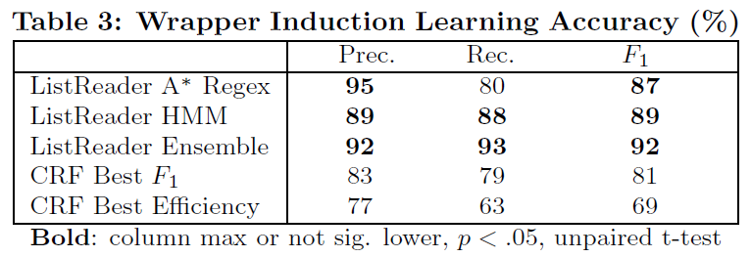
ListReader Accuracy
Tested on 60 hand-labeled lists (1254 fields)
Conditional Random Field from
http://mallet.cs.umass.edu/

Slide 21
Global Regex & HMM (Packer and Embley, 2014(a, b))

Slide 22
ListReader (Global)
ListReader
Scan Book Images
OCR Text
Find Records
Induce Grammar
Build Form & Label Selected Patterns
Text to Ontology Mapping
Database Querying & Reasoning
Data Entry Form
OCR Text
“click”

Slide 23
Global Induction: Basic Ideas
Document Text
1. Samuel Holden Parsons, b. 1772, d. 1870, m. Elizabeth Sullivan.
2. Elizabeth, b. 1774, d. 1851, m. 1801 Edward Hill.
3. Lucia, b. 1777, d. 1778.
4. Lucia Mather, b. 1779, d. 1870, m. John Marvin.
5. Polly, b. 1782.
6. Phebe, b. 1783, d. 1805.
7. William Richard Henry, b. 1787, d. 1796.
8. Margaret Stoutenburgh, b. 1794.
Clustered and Aligned Text
5. Polly, b. 1782.
8. Margaret Stoutenburgh, b. 1794.
3. Lucia, b. 1777, d. 1778.
6. Phebe, b. 1783, d. 1805.
7. William Richard Henry, b. 1787, d. 1796.
1. Samuel Holden Parsons, b. 1772, d. 1870, m. Elizabeth Sullivan.
4. Lucia Mather, b. 1779, d. 1870, m. John Marvin.
2. Elizabeth, b. 1774, d. 1851, m. 1801 Edward Hill.

Slide 24
Conflated Superfluous Distinctions
Word Split over Newline
Numeral
Word
Space
Space Erroneously Inserted by OCR
Capitalized Word Sequence
… Rich-\nard Mather ;\n5. PoUy … .\n6. Phebe …
… [UpLo+];[Sp][Dg].[Sp][UpLo+] … .[Sp][Dg].[Sp][UpLo+] …

Slide 25
Suffix Tree
[UpLo+];[Sp][Dg].[Sp][UpLo+].[Sp][Dg].[Sp][UpLo+].[Sp]
[Sp][Dg].[Sp][UpLo+].[Sp]

Slide 26
Identify and Parse Field Groups
[Sp][Dg].[Sp][UpLo+],[Sp][Lo].[Sp][DgDgDgDg].[Sp]
\n1. Andrew, b. 1772.\n
\n2. Clarissa, b. 1774.\n
\n3. Elias, b. 1776.\n
\n5. PoUy , b. 1782.\n
\n5. Sylvester, b. 1782.\n
\n7. Charles, b. 1787.\n
\n8. Margaret Stoutenburgh, b. 1794.\n
[Sp][Dg].[Sp][UpLo+],[Sp][Lo].[Sp][DgDgDgDg],[Sp][Lo].[Sp][DgDgDgDg].[Sp]
\n4. William Lee, b. 1779, d. 1802.\n
\n6. Nathaniel Griswold, b. 1784, d. 1785.\n
\n3. Lucia, b. 1777, d. 1778.\n
\n6. Phebe, b. 1783, d. 1805.\n
\n7. William Richard Henry, b. 1787, d. 1796.\n
\n[Dg].[Sp][UpLo+]
, d. [DgDgDgDg]
, b. [DgDgDgDg]
.\n

Slide 27
Continue Parsing the Text

Slide 28
Generate Regex from Grammar
ID # 1234
(([\n])([\d]{1})(\.[ \n])(([A-Z]+[a-z]+|[A-Z]+[a-z]+[A-Z]+[a-z]+)))((( )?,)([ \n])(b)(\.)([ \n])([\d]{4}))((\.)([\n]))
\n6. Nathaniel Griswold, b. 1784, d. 1785.\n
(([\n])([\d]{1})(\.[ \n])(([A-Z]+[a-z]+|[A-Z]+[a-z]+[A-Z]+[a-z]+)))((( )?,)([ \n])(b)(\.)([ \n])([\d]{4}))((( )?,)([ \n])(b)(\.)([ \n])([\d]{4}))((\.)([\n]))

Slide 29
Query the User
(([\n])([\d]{1})(\.[ \n])(([A-Z]+[a-z]+|[A-Z]+[a-z]+[A-Z]+[a-z]+)))((( )?,)([ \n])(b)(\.)([ \n])([\d]{4}))((\.)([\n]))
\n1. Andrew, b. 1772.\n
\n2. Clarissa, b. 1774.\n
\n3. Elias, b. 1776.\n
\n5. PoUy , b. 1782.\n
\n5. Sylvester, b. 1782.\n
\n7. Charles, b. 1787.\n
\n8. Margaret Stoutenburgh, b. 1794.\n
(([\n])([\d]{1})(\.[ \n])(([A-Z]+[a-z]+|[A-Z]+[a-z]+[A-Z]+[a-z]+)))((( )?,)([ \n])(b)(\.)([ \n])([\d]{4}))((( )?,)([ \n])(b)(\.)([ \n])([\d]{4}))((\.)([\n]))
\n4. William Lee, b. 1779, d. 1802.\n
\n6. Nathaniel Griswold, b. 1784, d. 1785.\n
\n3. Lucia, b. 1777, d. 1778.\n
\n6. Phebe, b. 1783, d. 1805.\n
\n7. William Richard Henry, b. 1787, d. 1796.\n

Slide 30
Propagate Labels via Capture Group IDs
(([\n])([\d]{1})(\.[ \n])(([A-Z]+[a-z]+|[A-Z]+[a-z]+[A-Z]+[a-z]+)))((( )?,)([ \n])(b)(\.)([ \n])([\d]{4}))((\.)([\n]))
\n1. Andrew, b. 1772.\n
\n2. Clarissa, b. 1774.\n
\n3. Elias, b. 1776.\n
\n5. PoUy , b. 1782.\n
\n5. Sylvester, b. 1782.\n
\n7. Charles, b. 1787.\n
\n8. Margaret Stoutenburgh, b. 1794.\n
(([\n])([\d]{1})(\.[ \n])(([A-Z]+[a-z]+|[A-Z]+[a-z]+[A-Z]+[a-z]+)))((( )?,)([ \n])(b)(\.)([ \n])([\d]{4}))((( )?,)([ \n])(b)(\.)([ \n])([\d]{4}))((\.)([\n]))
\n4. William Lee, b. 1779, d. 1802.\n
\n6. Nathaniel Griswold, b. 1784, d. 1785.\n
\n3. Lucia, b. 1777, d. 1778.\n
\n6. Phebe, b. 1783, d. 1805.\n
\n7. William Richard Henry, b. 1787, d. 1796.\n
ID # 1234

Slide 31
F-measure Results
Tested on 68 hand-labeled pages (13,748 fields)
Statistically significant at p < 0.01 using an unpaired t-test

Slide 32
Precision Results
Tested on 68 hand-labeled pages (13,748 fields)
Statistically significant at p < 0.01 using an unpaired t-test

Slide 33
Recall Results
Area Under the Learning Curve
ListReader (Two-phase): 39.0%
CRF: 34.4%
ListReader (One-phase): 32.7%

Slide 34
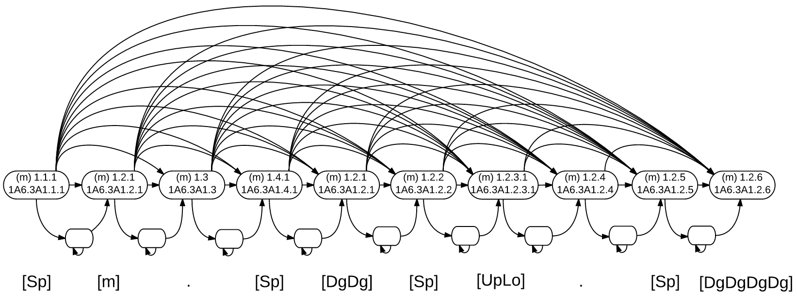
HMM Field Group Templates

Slide 35
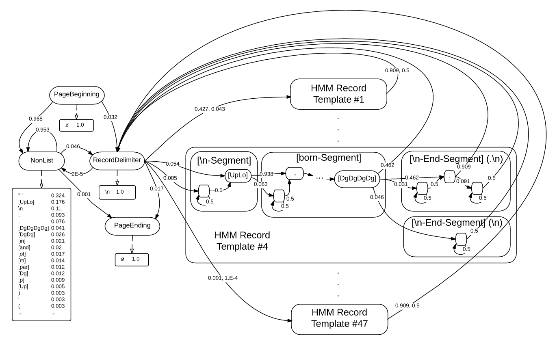
Complete HMM

Slide 36
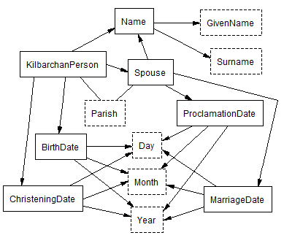
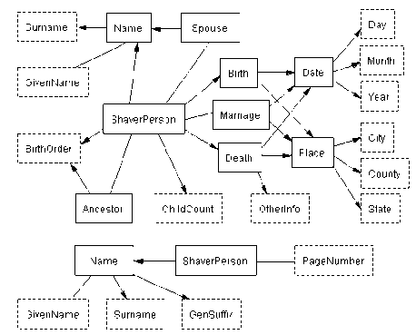
HMM Recall Results
Kilbarchan Parish Register
Shaver Family History

Slide 37
Conclusion

Slide 38
Dissertation Contributions
List detection
List wrapper induction
Mapping between in-line labeled text and ontology
A* admissible heuristic for regex induction
HMMs for list wrapping
AL query strategies
Linear/linear end-to-end ontology population with good learning curve, requiring no expert input (Regex)
Linear/quadratic end-to-end ontology population with better learning curve (HMM)

Slide 39
Contributions in a Nutshell
Wrapper induction is effective
Data in lists of OCRed documents
Low-cost ontology population

Slide 40
Appendix

Slide 41
Related Work

Slide 42
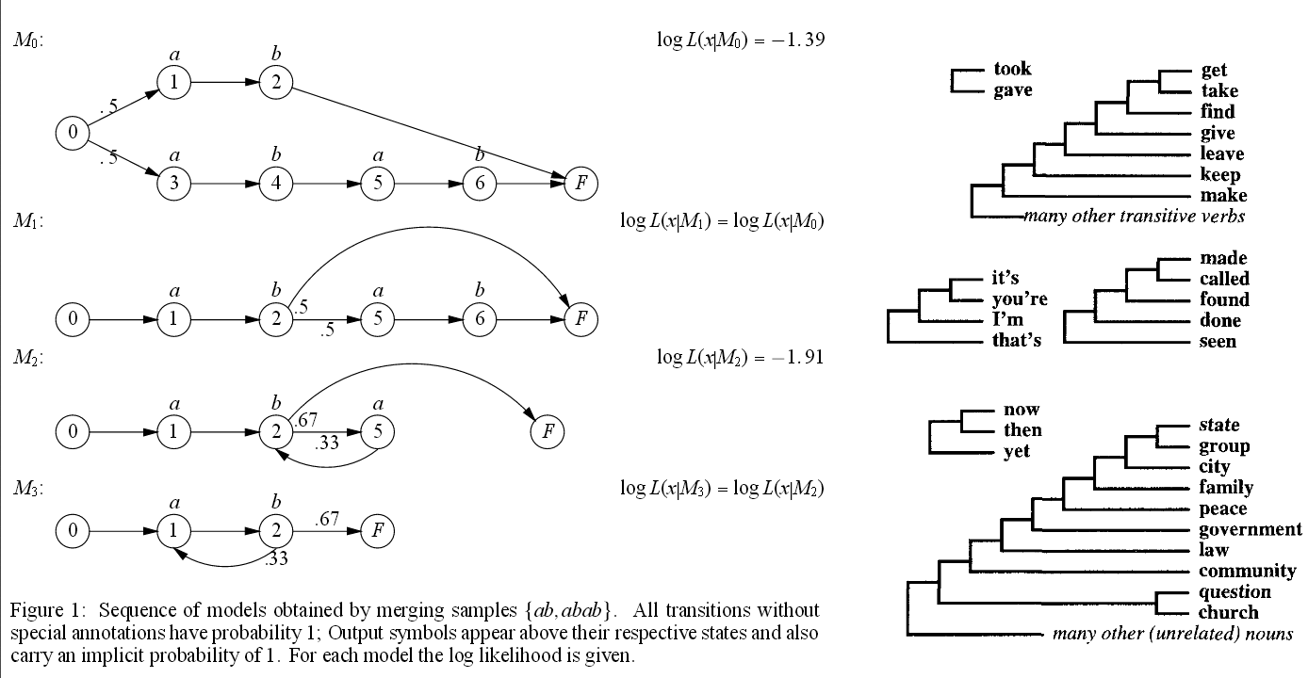
Grammar Induction
Purpose
Automatically infer a natural formal grammar for a language given a sample of unlabeled strings
Papers
Adriaans, 2006
Wolff, 2003
Grünwald, 1996
Stolcke, 1993
Wolff, 1977
Limitations
Higher algorithmic complexity
Not an end-to-end solution

Slide 43
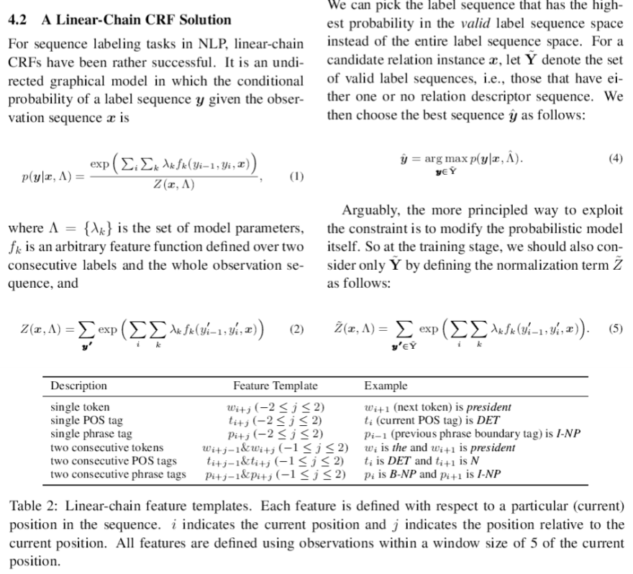
Probabilistic Finite State Automata for Information Extraction
Purpose
Infer a PFSA to automatically infer a label sequence from a word sequence
Papers
Li, 2011
Heidorn, 2008
Borkar, 2001
Limitations
Requires customized knowledge resources
Requires supervision
Lower output versatility

Slide 44
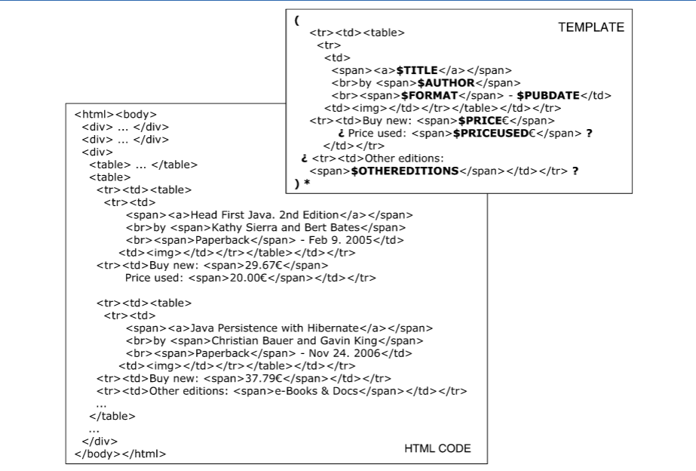
Web Wrapper Induction
Purpose
Scalably infer a specialized grammar of a Web site and a mapping from pages to database
Papers
Gentile, 2013
Dalvi, 2010
Elmeleegy, 2009
Gupta, 2009
Carlson, 2008
Chang, 2003
Crescenzi, 2001
Limitations
Not designed for OCR text
Usually limited in output expressiveness

Slide 45
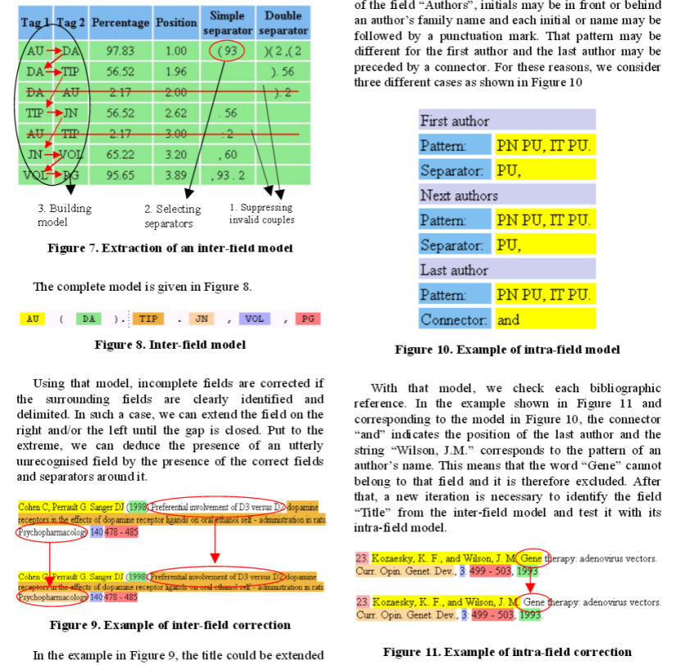
Specialized Document Analysis and Recognition Systems
Purpose
Automatically extract information from specific types of machine-printed records
Papers
Le, 2005
Besagni, 2004
Besagni, 2003
Belaïd, 2001
Belaïd, 1998
Limitations
Requires a lot of custom rule and resource engineering
Less scalable over multiple domains or kinds of lists
Many rely on page images which may not be available

Slide 46
Appendix

Slide 47
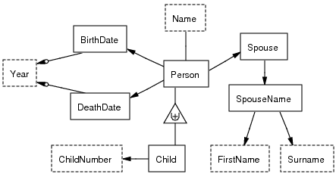
ListReader
from OCRed Text
to Populated Ontology

Slide 48
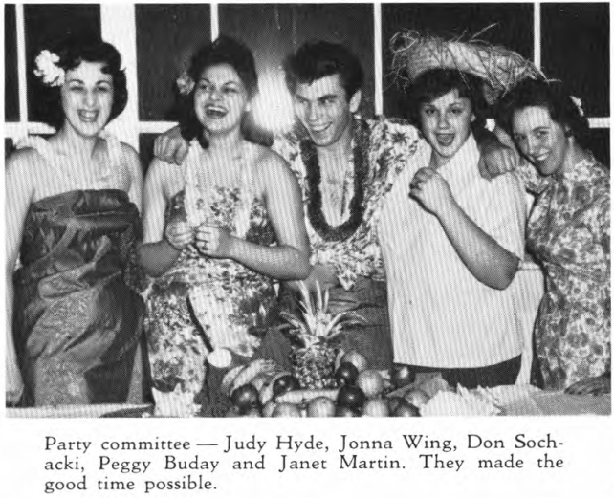
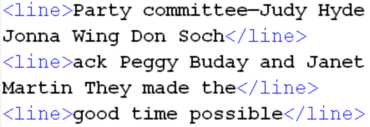
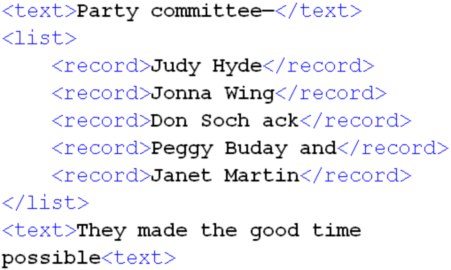
General List Reading Pipeline
OCR
List Detection
List Structure Recognition
Information Extraction

Slide 49
Challenges

Slide 50
OCR Challenges
\nFirst row, left to right: C. Paulson, G. Whaley, E Eastlund, B. Krohg, D. Bakken, R. Norgaard, 0. Bakken, A. Vig,\nH. Megorden, D Wynne\nSecond row- Mr. See bach, D. Colligan, J. Wogsland, F Knudson, A. Hagen, R. Myhrum, R. Nienaber, J. Mittun,\nMr. Bohnsack.\nThird row: G. Carlm, R. Reterson, K Larson, J Skatvold, A. Enckson, R Roysland, L.Johnson, L. Nystrom.\nFourth row: R. Kvare, H. Haugen, R. Lubken, R Larson, A. Carlson, A. Nienaber, W Ram bo I, V Hanson, K. Ny-\nQootLaM "leam\nCaptain Donald "Dude" Bakken ............... Right Half Back\nLeRov "Sonny' Johnson ........ ..........,.... Lcft Half Back\nOrley Bakken ...........,........ ... ,.......... Quarter Back\nRoger Myhrum .............. ..................... Full Back\nBill "Schnozz" Krohg .............. ................ Center\nHoward "Little Huby" Megorden ................ Right Guard\nRoyce "Shorty" Norgaard ....................... Left Guard\nEugene "Mad Russian" Easthind ............... Right Tackle\nAlvin "Stuben" Hagen ......................... Left Tackle\nRichard "Dick" Nienabcr ........................ Right End\nJames "Oakie" Wogsland .......................... Lcft End\n\nOther lettermen were-\nGlenn "Doc" Whaley\nAllen "Swede" Enckson\nJames "Snooky" Mittun\nCurtis "Curt" Paulson\nArthur "Art" Vig\nForrest "Forry" Knudson\nRobert "Bobby" Roysland\nPage 26\n
OCR
vs. HTML
<HTML>
…
<OL>
<LI>Captain Donald "Dude" Bakken ............... Right Half Back</LI>
<LI>LeRoy "Sonny” Johnson ....................... Left Half Back</LI>
<LI>Orley Bakken .................................. Quarter Back</LI>
<LI>Roger Myhrum ................................... Full Back</LI>
<LI>Bill "Schnozz" Krohg .............................. Center</LI>
<LI>Howard "Little Huby" Megorden ................ Right Guard</LI>
<LI>Royce "Shorty" Norgaard ....................... Left Guard</LI>
<LI>Eugene "Mad Russian" Eastlind ............... Right Tackle</LI>
…

Slide 51
Diversity Challenges

Slide 52
Versatile Output Schemas

Slide 53
Precision & Recall
Sibling Birth Order
Given Name
Birth Year
Ground Truth
\n1. Andrew, b. 1772.\n
Sibling Birth Order
Birth Year
Extractor
Predictions
\n1. Andrew, b. 1772.\n
False
Negative
(Recall
Error)
False
Positive
and
False
Negative
False
Positive
(Precision
Error)

Slide 54
Human Effort
OCR Text
“click”
Given Names
Ali
Alison
Alex
Andie
Andy
Ariel
Caroline
Chris
Cindy
Claire
Corey
Daisy
Diane
Emmy
Francis
Heather
Janey
Jojo
Kat
Katharine
Linda
…
Surnames
Adams
Allen
Anderson
Baker
Brown
Campbell
Clark
Davis
García
González
Green
Hall
Harris
Hernández
Hill
Jackson
Johnson
Jones
King
Lee
Lewis
…
Months
Jan.
January
Feb.
February
Mar.
March
Apr.
April
May
Jun.
June
Jul.
July
Aug.
August
Sep.
Sept.
September
Oct.
October
Nov.
…
Predicates
b.
born
born on
baptized
was baptized
was baptized on
was baptized in
d.
died
died on
m.
married
was married to
was married in
p.
parish
parishioner
c.
christening
was christened at
was christened in
…
Regular Expressions for Dates
^(0[1-9]|1[012])[- /.](0[1-9]|[12][0-9]|3[01])[- /.](19|20)\d\d$.
^(0[1-9]|[12][0-9]|3[01])[- /.](0[1-9]|1[012])[- /.](19|20)\d\d$ …
Regular Expression for Records
(([\n])([\d]{1})(\.[ \n])(([A-Z]+[a-z]+|[A-Z]+[a-z]+[A-Z]+[a-z]+)|([A-Z]+[a-z]+|[A-Z]+[a-z]+[A-Z]+[a-z]+)([ \n])([A-Z]+[a-z]+|[A-Z]+[a-z]+[A-Z]+[a-z]+)|([A-Z]+[a-z]+|[A-Z]+[a-z]+[A-Z]+[a-z]+)([ \n])([A-Z]+[a-z]+|[A-Z]+[a-z]+[A-Z]+[a-z]+)([ \n])([A-Z]+[a-z]+|[A-Z]+[a-z]+[A-Z]+[a-z]+)|([A-Z]+[a-z]+|[A-Z]+[a-z]+[A-Z]+[a-z]+)([ \n])([A-Z]+[a-z]+|[A-Z]+[a-z]+[A-Z]+[a-z]+)([ \n])([A-Z]+[a-z]+|[A-Z]+[a-z]+[A-Z]+[a-z]+)([ \n])([A-Z]+[a-z]+|[A-Z]+[a-z]+[A-Z]+[a-z]+)|([A-Z]+[a-z]+|[A-Z]+[a-z]+[A-Z]+[a-z …

Slide 55
ListReader Solution

Slide 56
ListReader
ListReader
Scan Book Images
OCR Text
List & Record Discovery
Field Labeling
Text to Ontology Mapping
Database Querying & Reasoning
Data Entry Form
OCR Text
“click”

Slide 57
Another High-level View of ListReader
1555. Elias Mather, b. 1750, d. 1788, son of Deborah Ely and Rich-
ard Mather; m. 1771, Lucinda Lee, who was b. 1752, dau. of Abner Lee
and EHzabeth Lee. Their children :—
1. Andrew, b. 1772.
2. Clarissa, b. 1774.
3. Elias, b. 1776.
4. William Lee, b. 1779, d. 1802.
5. Sylvester, b. 1782.
6. Nathaniel Griswold, b. 1784, d. 1785.
7. Charles, b. 1787.
1556. Deborah Mather, b. 1752, d. 1826, dau. of Deborah Ely and
Richard Mather; m. 1771, Ezra Lee, who was b. 1749 and d. 1821, son
of Abner Lee and Elizabeth Lee. Their children :—
1. Samuel Holden Parsons, b. 1772, d. 1870, m. Elizabeth Sullivan.
2. Elizabeth, b. 1774, d. 1851, m. 1801 Edward Hill.
3. Lucia, b. 1777, d. 1778.
4. Lucia Mather, b. 1779, d. 1870, m. John Marvin.
5. PoUy , b. 1782.
6. Phebe, b. 1783, d. 1805.
7. William Richard Henry, b. 1787, d. 1796.
8. Margaret Stoutenburgh, b. 1794.

Slide 58
Data Mapping (Packer and Embley, 2014b, 2014a, 2013)

Slide 59
ListReader Mapping
Structural Distinction | Predicates | Labels
1. Lexical vs. non-lexical | Person(p1) vs. GivenName(“Elizabeth”) | Person.GivenName[1] Elizabeth
2. N-ary relationships | Person-SpouseName-MarriageDate(p1, “Edward”, “1801”) | Person.(MarriageDate)SpouseName Edward
3. M degrees of separation | Person-DeathDate(p1, dd1), DeathDate-Year(dd1, “1851”) | Person.DeathDate.Year 1851
4. Functionality and optionality | Person-GivenName() vs. Person-Surname() | Person.GivenName[1] Person.Surname Elizabeth Hill
5. Generalization-specialization class hierarchies | Person vs. Child | Child.ChildNr 2
6. Non-tree ontology structure | Person-BirthDate(p1, bd1), BirthDate-Year(bd1, “1774”) Person-DeathDate(p1, dd1), DeathDate-Year (dd1, “1851”) | Person.BirthDate.Year Person.DeathDate.Year 1774 1851
2. Elizabeth, b. 1774, d. 1851, m. 1801 Edward Hill.

Slide 60
Unsupervised List Detection (Packer and Embley, 2012)

Slide 61
Literal Pattern Area
Score =
3 x 7 = 21

Slide 62
Pattern Area
Score =
6 x 7 = 42

Slide 63
Matching Word Categories
The word itself, case sensitive
Dictionaries (& sizes):
Given name ……………….. 8,400
Surname ………………… 142,000
Title ………………………………… 13
Australian city ………………. 200
Australian state ………………… 8
Religion ………………………….. 15
Regular expressions:
Numeral ………………… [0-9]{1,4}
Initial + dot ……………. [A-Z] \.
Initial …………………….. [A-Z]
Capitalized word ....... [A-Z][a-z]*

Slide 64
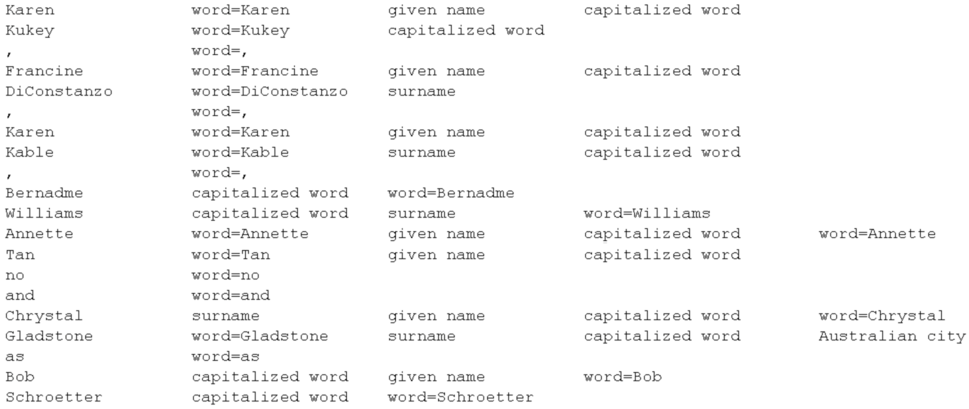
Label Selector 1: Naïve Bayes Classifier
OCR Text Noisy Word Categories

Slide 65
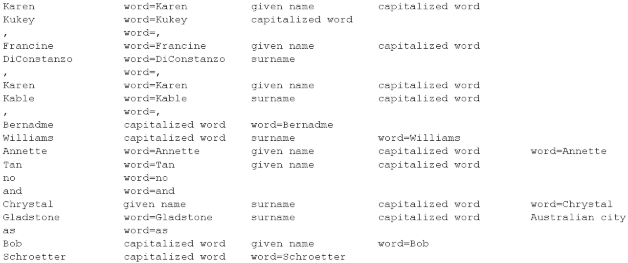
Label Selector 2: Standard Deviation
OCR Text Noisy Word Categories

Slide 66
26 Pages for Dev / Parameter Setting, F-measure on 16 Separate Test Pages

Slide 67
Local Regex (Packer and Embley, 2013)

Slide 68
newline First row, left to right: C. Paulson, G. Whaley, E Eastlund, B. Krohg, D. Bakken, R. Norgaard, 0. Bakken, A. Vig, newline H. Megorden, D Wynne newline Second row- Mr. See bach, D. Colligan, J. Wogsland, F Knudson, A. Hagen, R. Myhrum, R. Nienaber, J. Mittun, newline Mr. Bohnsack. newline Third row: G. Carlm, R. Reterson, K Larson, J Skatvold, A. Enckson, R Roysland, L.Johnson, L. Nystrom. newLine Fourth row: R. Kvare, H. Haugen, R. Lubken, R Larson, A. Carlson, A. Nienaber, W Ram bo I, V Hanson, K. Ny- newline newline QootLaM "leam newline Captain Donald "Dude" Bakken ............... Right Half Back newline LeRoy "Sonny' Johnson ..................,.... Lcft Half Back newline Orley Bakken ...........,...........,.......... Quarter Back newline Roger Myhrum ................................... Full Back newline Bill "Schnozz" Krohg .............................. Center newline Howard "Little Huby" Megorden ................ Right Guard newline Royce "Shorty" Norgaard ....................... Left Guard newline Eugene "Mad Russian" Easthind ............... Right Tackle newline Alvin "Stuben" Hagen ......................... Left Tackle newline Richard "Dick" Nienabcr ........................ Right End newline James "Oakie" Wogsland .......................... Lcft End newline newline Other lettermen were- newline Glenn "Doc" Whaley newline Allen "Swede" Enckson newline James "Snooky" Mittun newline Curtis "Curt" Paulson newline Arthur "Art" Vig newline Forrest "Forry" Knudson newline Robert "Bobby" Roysland newline Page 26 newline
OCR

Slide 69
newline First row, left to right: C. Paulson, G. Whaley, E Eastlund, B. Krohg, D. Bakken, R. Norgaard, 0. Bakken, A. Vig, newline H. Megorden, D Wynne newline Second row- Mr. See bach, D. Colligan, J. Wogsland, F Knudson, A. Hagen, R. Myhrum, R. Nienaber, J. Mittun, newline Mr. Bohnsack. newline Third row: G. Carlm, R. Reterson, K Larson, J Skatvold, A. Enckson, R Roysland, L.Johnson, L. Nystrom. newLine Fourth row: R. Kvare, H. Haugen, R. Lubken, R Larson, A. Carlson, A. Nienaber, W Ram bo I, V Hanson, K. Ny- newline newline QootLaM "leam newline Captain Donald "Dude" Bakken ............... Right Half Back newline LeRoy "Sonny' Johnson ..................,.... Lcft Half Back newline Orley Bakken ...........,...........,.......... Quarter Back newline Roger Myhrum ................................... Full Back newline Bill "Schnozz" Krohg .............................. Center newline Howard "Little Huby" Megorden ................ Right Guard newline Royce "Shorty" Norgaard ....................... Left Guard newline Eugene "Mad Russian" Easthind ............... Right Tackle newline Alvin "Stuben" Hagen ......................... Left Tackle newline Richard "Dick" Nienabcr ........................ Right End newline James "Oakie" Wogsland .......................... Lcft End newline newline Other lettermen were- newline Glenn "Doc" Whaley newline Allen "Swede" Enckson newline James "Snooky" Mittun newline Curtis "Curt" Paulson newline Arthur "Art" Vig newline Forrest "Forry" Knudson newline Robert "Bobby" Roysland newline Page 26 newline
newline First row, left to right: C. Paulson, G. Whaley, E Eastlund, B. Krohg, D. Bakken, R. Norgaard, 0. Bakken, A. Vig, newline H. Megorden, D Wynne newline Second row- Mr. See bach, D. Colligan, J. Wogsland, F Knudson, A. Hagen, R. Myhrum, R. Nienaber, J. Mittun, newline Mr. Bohnsack. newline Third row: G. Carlm, R. Reterson, K Larson, J Skatvold, A. Enckson, R Roysland, L.Johnson, L. Nystrom. newLine Fourth row: R. Kvare, H. Haugen, R. Lubken, R Larson, A. Carlson, A. Nienaber, W Ram bo I, V Hanson, K. Ny- newline newline QootLaM "leam newline Captain Donald "Dude" Bakken ............... Right Half Back newline LeRoy "Sonny' Johnson ..................,.... Lcft Half Back newline Orley Bakken ...........,...........,.......... Quarter Back newline Roger Myhrum ................................... Full Back newline Bill "Schnozz" Krohg .............................. Center newline Howard "Little Huby" Megorden ................ Right Guard newline Royce "Shorty" Norgaard ....................... Left Guard newline Eugene "Mad Russian" Easthind ............... Right Tackle newline Alvin "Stuben" Hagen ......................... Left Tackle newline Richard "Dick" Nienabcr ........................ Right End newline James "Oakie" Wogsland .......................... Lcft End newline newline Other lettermen were- newline Glenn "Doc" Whaley newline Allen "Swede" Enckson newline James "Snooky" Mittun newline Curtis "Curt" Paulson newline Arthur "Art" Vig newline Forrest "Forry" Knudson newline Robert "Bobby" Roysland newline Page 26 newline
Hand Labeling

Slide 70
newline First row, left to right: C. Paulson, G. Whaley, E Eastlund, B. Krohg, D. Bakken, R. Norgaard, 0. Bakken, A. Vig, newline H. Megorden, D Wynne newline Second row- Mr. See bach, D. Colligan, J. Wogsland, F Knudson, A. Hagen, R. Myhrum, R. Nienaber, J. Mittun, newline Mr. Bohnsack. newline Third row: G. Carlm, R. Reterson, K Larson, J Skatvold, A. Enckson, R Roysland, L.Johnson, L. Nystrom. newLine Fourth row: R. Kvare, H. Haugen, R. Lubken, R Larson, A. Carlson, A. Nienaber, W Ram bo I, V Hanson, K. Ny- newline newline QootLaM "leam newline Captain Donald "Dude" Bakken ............... Right Half Back newline LeRoy "Sonny' Johnson ..................,.... Lcft Half Back newline Orley Bakken ...........,...........,.......... Quarter Back newline Roger Myhrum ................................... Full Back newline Bill "Schnozz" Krohg .............................. Center newline Howard "Little Huby" Megorden ................ Right Guard newline Royce "Shorty" Norgaard ....................... Left Guard newline Eugene "Mad Russian" Easthind ............... Right Tackle newline Alvin "Stuben" Hagen ......................... Left Tackle newline Richard "Dick" Nienabcr ........................ Right End newline James "Oakie" Wogsland .......................... Lcft End newline newline Other lettermen were- newline Glenn "Doc" Whaley newline Allen "Swede" Enckson newline James "Snooky" Mittun newline Curtis "Curt" Paulson newline Arthur "Art" Vig newline Forrest "Forry" Knudson newline Robert "Bobby" Roysland newline Page 26 newline
newline Captain Donald "Dude" Bakken ............... Right Half Back newline LeRoy "Sonny' Johnson ..................,.... Lcft Half Back newline Orley Bakken ...........,...........,.......... Quarter Back newline Roger Myhrum ................................... Full Back newline Bill "Schnozz" Krohg .............................. Center newline Howard "Little Huby" Megorden ................ Right Guard newline Royce "Shorty" Norgaard ....................... Left Guard newline Eugene "Mad Russian" Easthind ............... Right Tackle newline Alvin "Stuben" Hagen ......................... Left Tackle newline Richard "Dick" Nienabcr ........................ Right End newline James "Oakie" Wogsland .......................... Lcft End newline newline Other lettermen were- newline Glenn "Doc" Whaley newline Allen "Swede" Enckson newline James "Snooky" Mittun newline Curtis "Curt" Paulson newline Arthur "Art" Vig newline Forrest "Forry" Knudson newline Robert "Bobby" Roysland newline Page 26 newline
List Start Detection

Slide 71
newline Captain Donald "Dude" Bakken ............... Right Half Back newline LeRoy "Sonny' Johnson ..................,.... Lcft Half Back newline Orley Bakken ...........,...........,.......... Quarter Back newline Roger Myhrum ................................... Full Back newline Bill "Schnozz" Krohg .............................. Center newline Howard "Little Huby" Megorden ................ Right Guard newline Royce "Shorty" Norgaard ....................... Left Guard newline Eugene "Mad Russian" Easthind ............... Right Tackle newline Alvin "Stuben" Hagen ......................... Left Tackle newline Richard "Dick" Nienabcr ........................ Right End newline James "Oakie" Wogsland .......................... Lcft End newline newline Other lettermen were- newline Glenn "Doc" Whaley newline Allen "Swede" Enckson newline James "Snooky" Mittun newline Curtis "Curt" Paulson newline Arthur "Art" Vig newline Forrest "Forry" Knudson newline Robert "Bobby" Roysland newline Page 26 newline
Captain Donald "Dude" Bakken ............... Right Half Back newline
LeRoy "Sonny' Johnson ..................,.... Lcft Half Back newline
Orley Bakken ...........,...........,.......... Quarter Back newline
Roger Myhrum ................................... Full Back newline
Bill "Schnozz" Krohg .............................. Center newline
Howard "Little Huby" Megorden ................ Right Guard newline
Royce "Shorty" Norgaard ....................... Left Guard newline
Eugene "Mad Russian" Easthind ............... Right Tackle newline
Alvin "Stuben" Hagen ......................... Left Tackle newline
Richard "Dick" Nienabcr ........................ Right End newline
James "Oakie" Wogsland .......................... Lcft End newline
newline
Other lettermen were- newline
Glenn "Doc" Whaley newline
Allen "Swede" Enckson newline
James "Snooky" Mittun newline
Curtis "Curt" Paulson newline
Arthur "Art" Vig newline
Forrest "Forry" Knudson newline
Robert "Bobby" Roysland newline
Page 26 newline
Record Boundary Detection

Slide 72
Wrapper for First Record
Captain Donald "Dude" Bakken ............... Right Half Back newline
LeRoy "Sonny' Johnson ..................,.... Lcft Half Back newline
Orley Bakken ...........,...........,.......... Quarter Back newline
Roger Myhrum ................................... Full Back newline
Bill "Schnozz" Krohg .............................. Center newline
Howard "Little Huby" Megorden ................ Right Guard newline
Royce "Shorty" Norgaard ....................... Left Guard newline
Eugene "Mad Russian" Easthind ............... Right Tackle newline
Alvin "Stuben" Hagen ......................... Left Tackle newline
Richard "Dick" Nienabcr ........................ Right End newline
James "Oakie" Wogsland .......................... Lcft End newline
newline
Other lettermen were- newline
Glenn "Doc" Whaley newline
Allen "Swede" Enckson newline
James "Snooky" Mittun newline
Curtis "Curt" Paulson newline
Arthur "Art" Vig newline
Forrest "Forry" Knudson newline
Robert "Bobby" Roysland newline
Page 26 newline

Slide 73
Update and Label using First Wrapper
Captain Donald "Dude" Bakken ............... Right Half Back newline
LeRoy "Sonny' Johnson ..................,.... Lcft Half Back newline
Orley Bakken ...........,...........,.......... Quarter Back newline
Roger Myhrum ................................... Full Back newline
Bill "Schnozz" Krohg .............................. Center newline
Howard "Little Huby" Megorden ................ Right Guard newline
Royce "Shorty" Norgaard ....................... Left Guard newline
Eugene "Mad Russian" Easthind ............... Right Tackle newline
Alvin "Stuben" Hagen ......................... Left Tackle newline
Richard "Dick" Nienabcr ........................ Right End newline
James "Oakie" Wogsland .......................... Lcft End newline
newline
Other lettermen were- newline
Glenn "Doc" Whaley newline
Allen "Swede" Enckson newline
James "Snooky" Mittun newline
Curtis "Curt" Paulson newline
Arthur "Art" Vig newline
Forrest "Forry" Knudson newline
Robert "Bobby" Roysland newline
Page 26 newline

Slide 74
Update and Label using First Wrapper
Captain Donald "Dude" Bakken ............... Right Half Back newline
LeRoy "Sonny' Johnson ..................,.... Lcft Half Back newline
Orley Bakken ...........,...........,.......... Quarter Back newline
Roger Myhrum ................................... Full Back newline
Bill "Schnozz" Krohg .............................. Center newline
Howard "Little Huby" Megorden ................ Right Guard newline
Royce "Shorty" Norgaard ....................... Left Guard newline
Eugene "Mad Russian" Easthind ............... Right Tackle newline
Alvin "Stuben" Hagen ......................... Left Tackle newline
Richard "Dick" Nienabcr ........................ Right End newline
James "Oakie" Wogsland .......................... Lcft End newline
newline
Other lettermen were- newline
Glenn "Doc" Whaley newline
Allen "Swede" Enckson newline
James "Snooky" Mittun newline
Curtis "Curt" Paulson newline
Arthur "Art" Vig newline
Forrest "Forry" Knudson newline
Robert "Bobby" Roysland newline
Page 26 newline

Slide 75
Final Wrapper & Extraction
Captain Donald "Dude" Bakken ............... Right Half Back newline
LeRoy "Sonny' Johnson ..................,.... Lcft Half Back newline
Orley Bakken ...........,...........,.......... Quarter Back newline
Roger Myhrum ................................... Full Back newline
Bill "Schnozz" Krohg .............................. Center newline
Howard "Little Huby" Megorden ................ Right Guard newline
Royce "Shorty" Norgaard ....................... Left Guard newline
Eugene "Mad Russian" Easthind ............... Right Tackle newline
Alvin "Stuben" Hagen ......................... Left Tackle newline
Richard "Dick" Nienabcr ........................ Right End newline
James "Oakie" Wogsland .......................... Lcft End newline
newline
Other lettermen were- newline
Glenn "Doc" Whaley newline
Allen "Swede" Enckson newline
James "Snooky" Mittun newline
Curtis "Curt" Paulson newline
Arthur "Art" Vig newline
Forrest "Forry" Knudson newline
Robert "Bobby" Roysland newline
Page 26 newline

Slide 76
Precision & Recall
Ground
Truth
Birth Order
Given Name
Birth Year
\n1. Andrew, b. 1772.\n
Extractor
Predictions
Birth Order
Birth Year
\n1. Andrew, b. 1772.\n
False
Negative
(Recall
Error)
False
Positive
and
False
Negative
False
Positive
(Precision
Error)

Slide 77
Evaluation
Evaluated on 60 short-record lists from “The Ely Ancestry” family history book containing 3088 non-space word tokens, 1254 extractable field strings

Slide 78
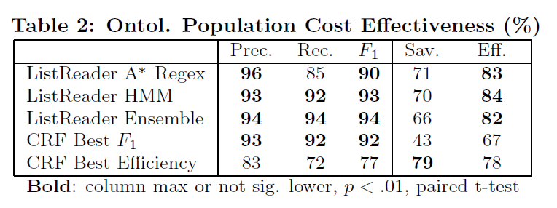
ListReader Efficiency

Slide 79
Local HMM (Packer and Embley, 2013)

Slide 80
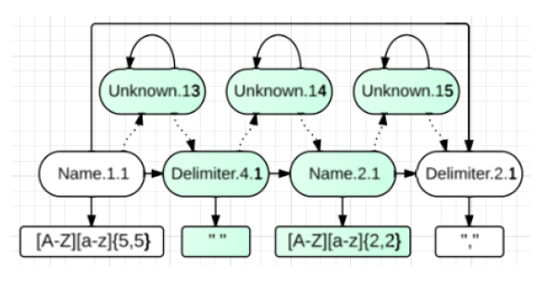
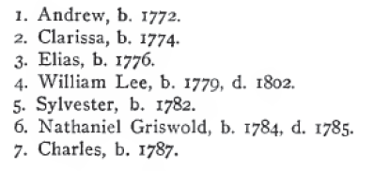
HMM Induction
Initialize
Active Learning
(Novelty Detection)

Slide 81
HMM Modeling Details
Sparse, Noisy Data:
Parameter smoothing: Prior knowledge as non-zero Dirichlet priors
Emission model parameter tying for shared lexical object sets
Cluster field words in emiss. model with 5 character classes
List Structure:
Transition model is fine-grained total order among word states
Tr. model is cyclical only at record delimiters
Tr. model is a total order: non-zero priors allow for deletions
Tr. model has unique “unknown” states to allow for insertions
Delimiter state emiss. models don’t use word clustering like field states

Slide 82
Global Regex (Packer and Embley, 2014a)

Slide 83
AUL Results
Area Under the Learning Curve
Prec.
CRF: 54.1
ListReader (One-phase): 95.6
ListReader (Two-phase): 94.4
Rec.
CRF: 34.4
ListReader (One-phase): 32.7
ListReader (Two-phase): 39.0
F1
CRF: 39.5
ListReader (One-phase): 48.6
ListReader (Two-phase): 55.1

Slide 84
Global HMM (Packer and Embley, 2014b)

Slide 85
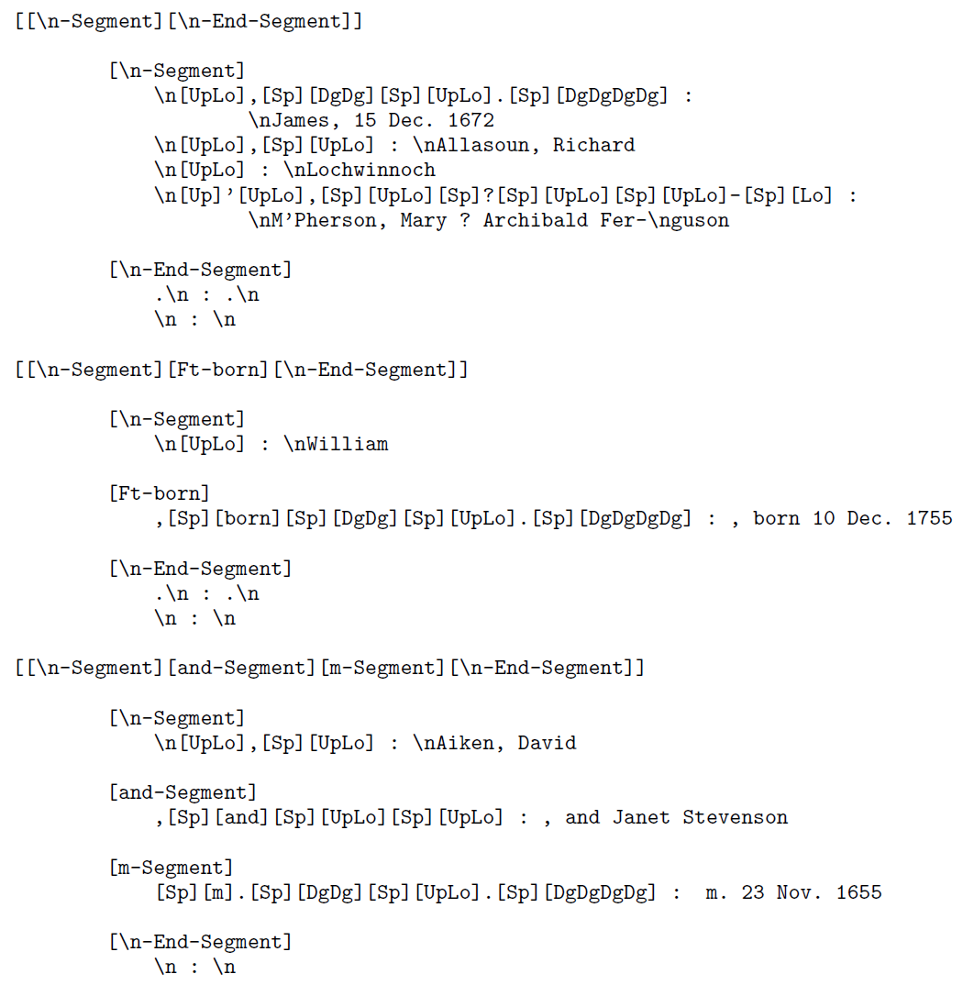
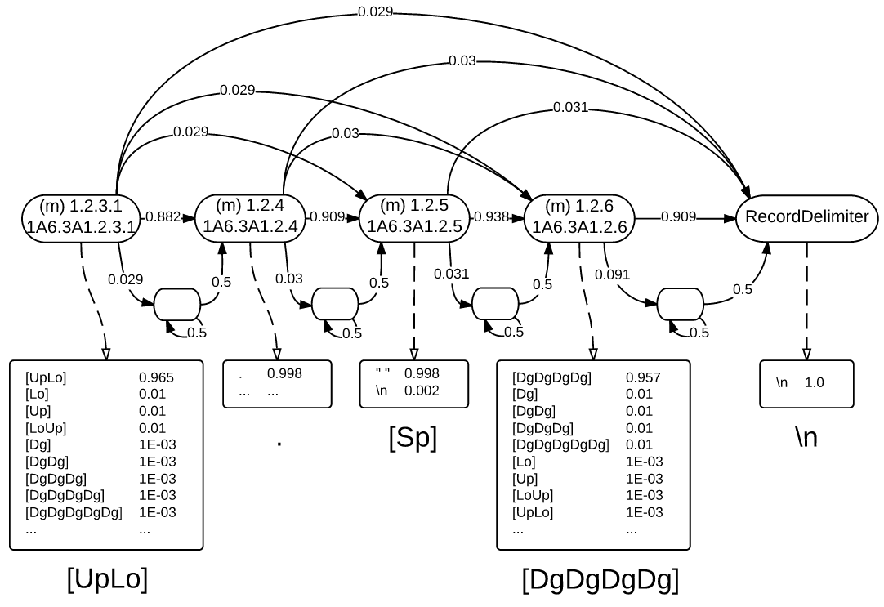
HMM Field Group Template

Slide 86
F-measure Results

Slide 87
Precision Results

Slide 88
Recall Results

Slide 90
ListReader
ListReader Form
OCR Text
“click”
Unsupervised Active Learning Pipeline
Conflate Text
Build Suffix Tree
Find Record Patterns in Tree
Find Major Fields in Record Clusters
Generate Regex Templates
Request Labels from User
---------------------- Phase One ----------------------
---- Phase Two ----

Slide 91
ListReader
Child(p₁)
Person(p₁)
Child-ChildNumber(p₁, “1”)
Child-Name(p₁, n₁)
…

Slide 92
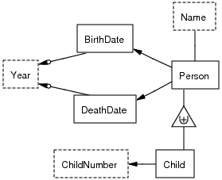
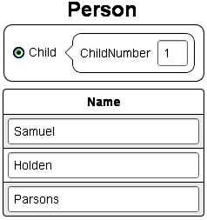
ListReader Pieces
Four types of knowledge rep. and mappings:
Predicates in ontologies
Labeled fields in plain text
List wrappers (regex)
Data entry forms
\n[Dg].[Sp][UpLo+].\n

